Slide 1
IUP Heidelberg
Status of Ground-Based Network
Udo Frieß
Institute of Environmental Physics
University of Heidelberg
Germany

Slide 2
Contents
Status of the IUPHD Ground-Based Network
Profile retrieval algorithm
Selected Results
Technical Issues: NORS Data format

Slide 3
The IUPHD MAX-DOAS Ground-Based Network

Slide 4
The IUPHD MAX-DOAS Ground-Based Network
- Status -
Alert, Canada:
  Operated in collaboration with Environment Canada
  Instrument installed in 2008
  Various instrumental problems since then
  Instrument shipped to Heidelberg for maintenance in Autumn 2011
  Now continuously operational
Hohenpeißenberg, Germany:
  Operated in collaboration with German Weather Service (DWD)
  New instrument operational since 2008
  2D scanner
  Extended measurement geometry with direct sunlight and almucantar measurements since March 2012
  Unfortunately, our Diploma student abandoned...
  DWD plans to employ a postdoc for the MAX-DOAS this year
Zugspitze, Germany:
  Operated in collaboration with DLR
  MAX-DOAS measurements since January 2001
  High altitude station (2650 m asl)

Slide 5
The IUPHD MAX-DOAS Ground-Based Network
- Status -
Cape Verde:
  Measurements since 2006 with varying quality
Suriname:
  MAX-DOAS measurements since 2002
  Improved entrance optics installed in 2009
Neumayer Station, Antarctica:
  Continuous operation since 1999
  Initially zenith-sky only, MAX-DOAS telescope installed in 2005
  Re-analysis of complete time series with current NDACC recommendations in progress
Arrival Heights, Antarctica:
  In cooperation with NIWA Lauder
  Continuous MAX-DOAS measurements since 1998
  Re-analysis of complete time series with current NDACC recommendations in progress
Polarstern:
  Permanently installed MAX-DOAS instrument
  Currently operating without any problems (after maintenance in Autumn 2011)

Slide 6
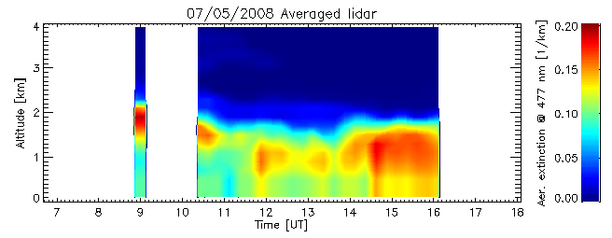
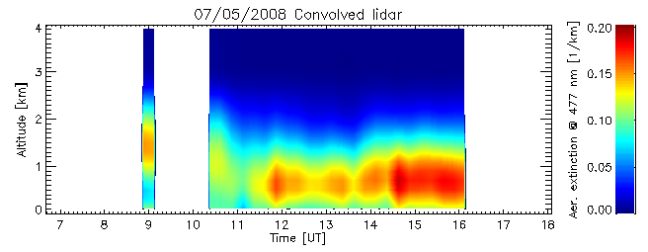
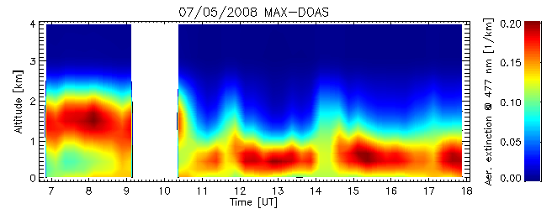
Aerosol and Trace Gas Profile Retrieval Algorithm
- Selami Yilmaz -
EUCAARI Campaign, Cabauw, 2008
Aerosol and trace gas vertical profile inversion algorithms.
Based on optimal estimation, with SCIATRAN (IUP Bremen) as forward model
New version with user-friendly interface recently released
Runs on IDL virtual machine

Slide 7
OASIS-Barrow 2009, Alaska
Aerosol Extinction from MAX-DOAS
- Comparison with ARM Ceilometer -
Ceilometer
Original
(ARM, 30 m grid)
Ceilometer
Degraded to MAX-
DOAS resolution
MAX-
DOAS
Frieß et al., JGR, 2011

Slide 8
OASIS-Barrow 2009, Alaska
Aerosol Optical Depth from MAX-DOAS
- Comparison with ARM Sun Photometer-

Slide 9
Barrow 2009 - Results

Slide 10
Comparison of BrO measured by LP-DOAS and CIMS
(Chemical Ionisation Mass Spectrometry)
Liao, J.; Huey, L. G.; Neuman, J. A.; Tanner, D. J.; Sihler, H.; Frieß, U.; Platt, U.; Flocke, F. M.; Orlando, J. J.; Shepson, P. B.; Beine, H. J.; Weinheimer, A.; Sjostedt, S. J.; Nowak, J. B. & Knapp, D.:
A comparison of Arctic BrO measurements by a chemical ionization mass spectrometer (CIMS) and a long path differential optical absorption spectrometer (LP-DOAS), submitted to J. Geophys. Res., 2010.

Slide 11
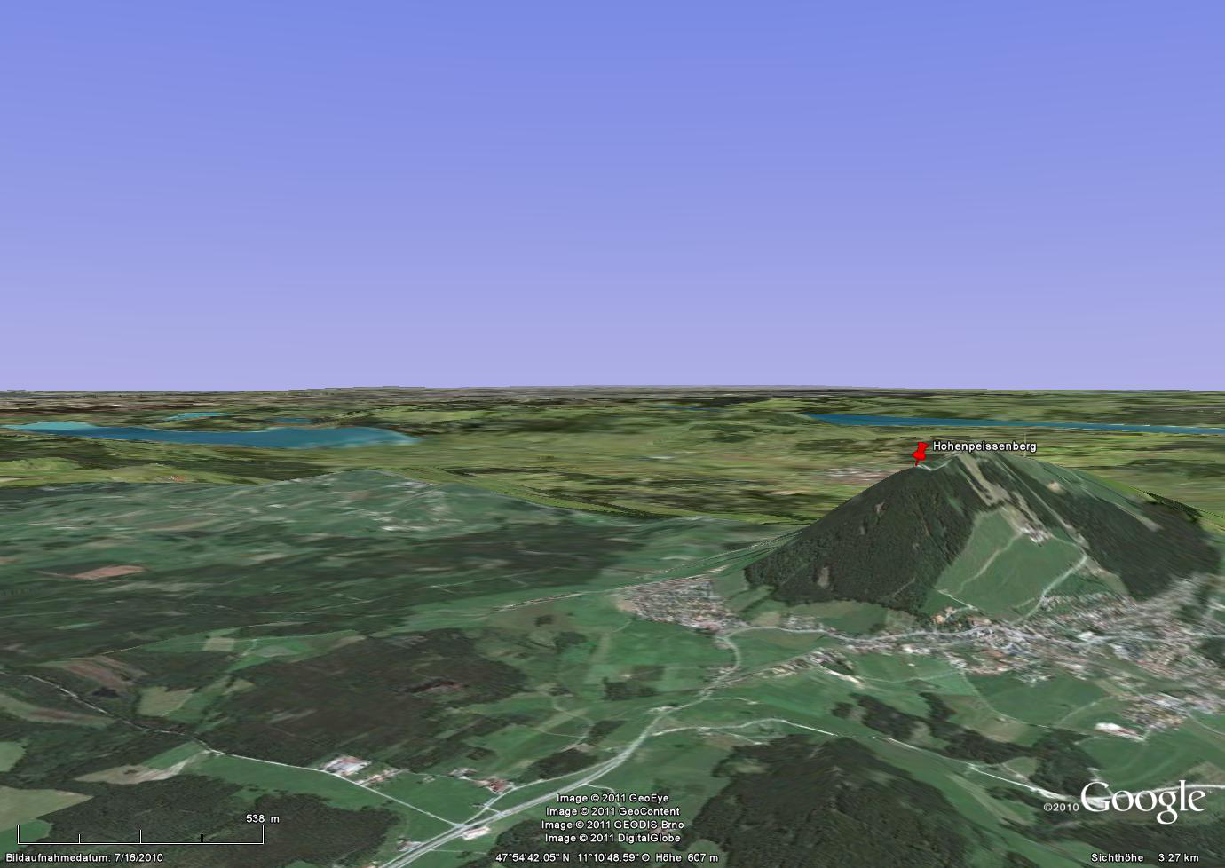
Hohenpeißenberg, Germany
90°
20°
10°
5°
100 m
2°
1°
-2°
200 m
-10°

Slide 12
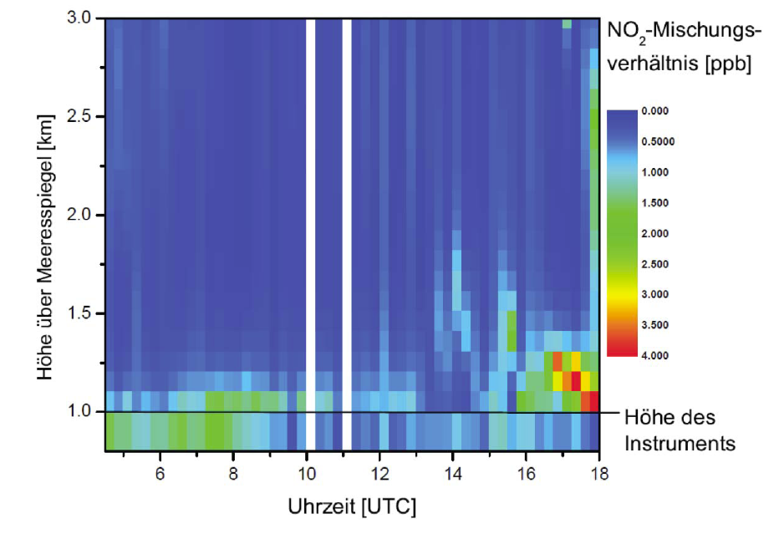
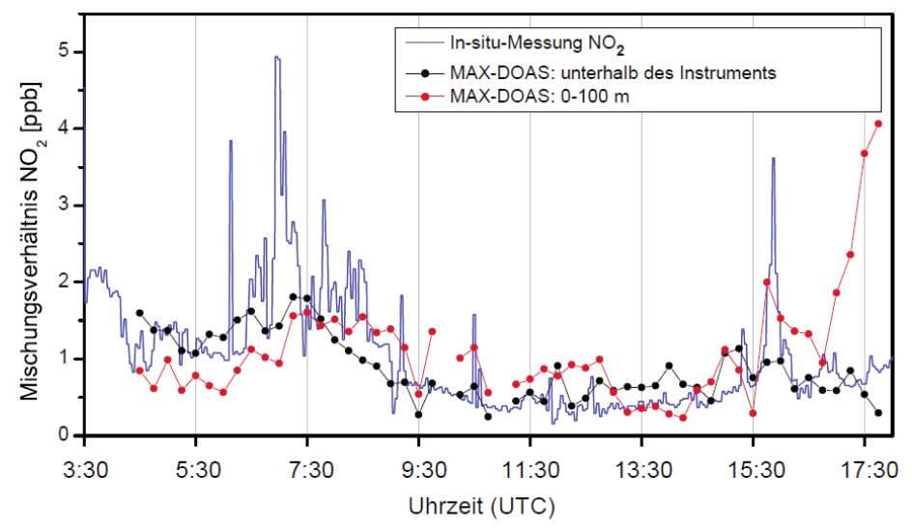
Hohenpeißenberg, Germany
NO₂ Profiles, 8.7.2010
NO₂ Surface Mixing Ratio
Comparison with in situ
Sabrina Niebling, Diploma Thesis

Slide 13
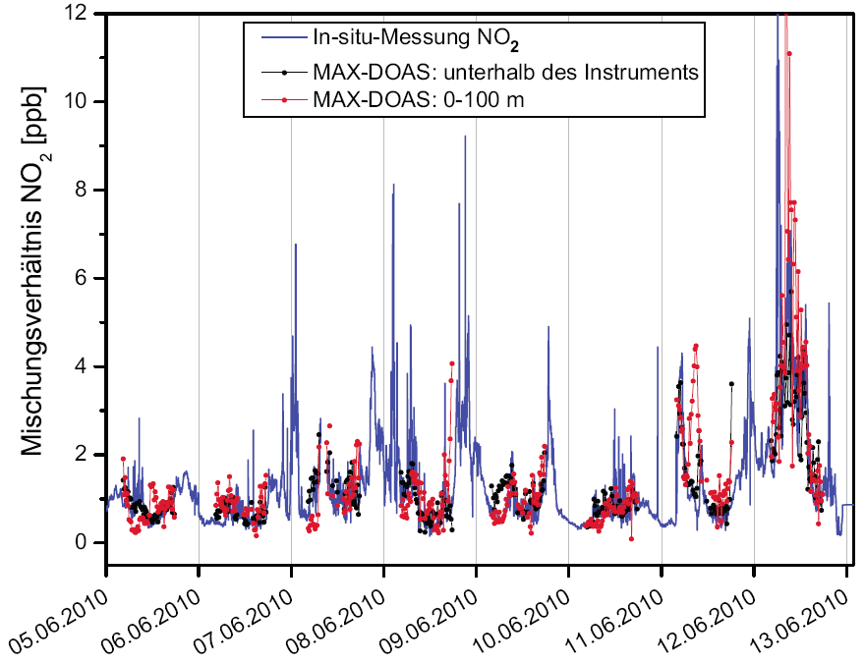
Hohenpeißenberg, Germany
NO₂ Surface Mixing Ratio – Comparison with in situ measurements
Sabrina Niebling, Diploma Thesis

Slide 14
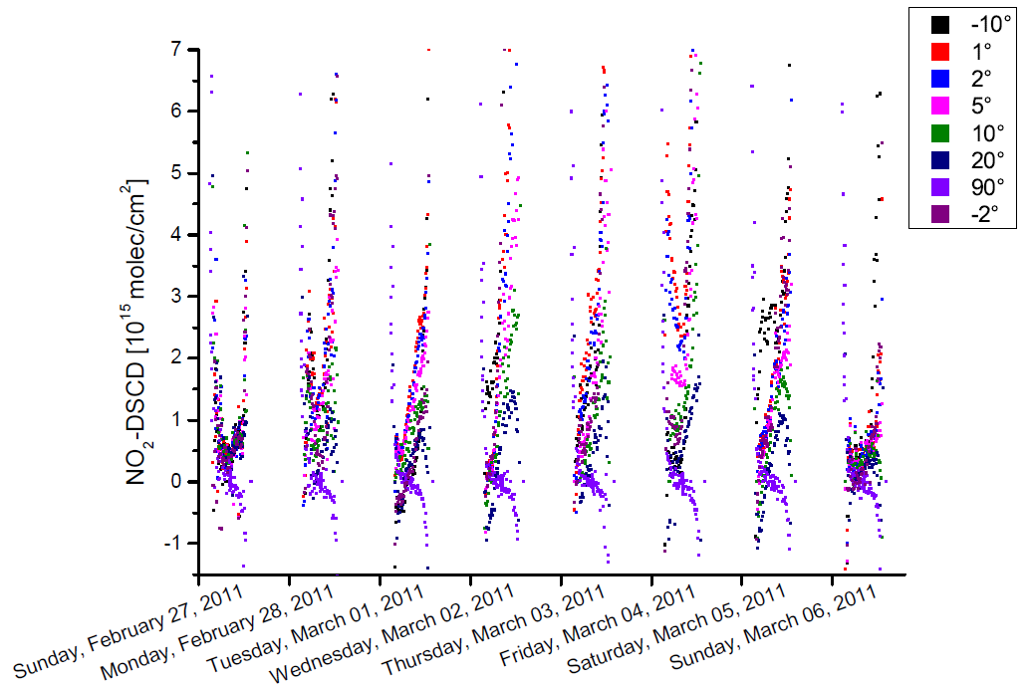
Zugspitze, Germany (2650 m a.s.l.)
NO₂ dSCDs (relative to current zenith sky measurement)
Combination of measurements at Hohenpeißenberg and Zugspitze would allow to estimate vertical profiles both in boundary layer and free troposphere.
Moritz Jurgschat, Diploma Thesis

Slide 15
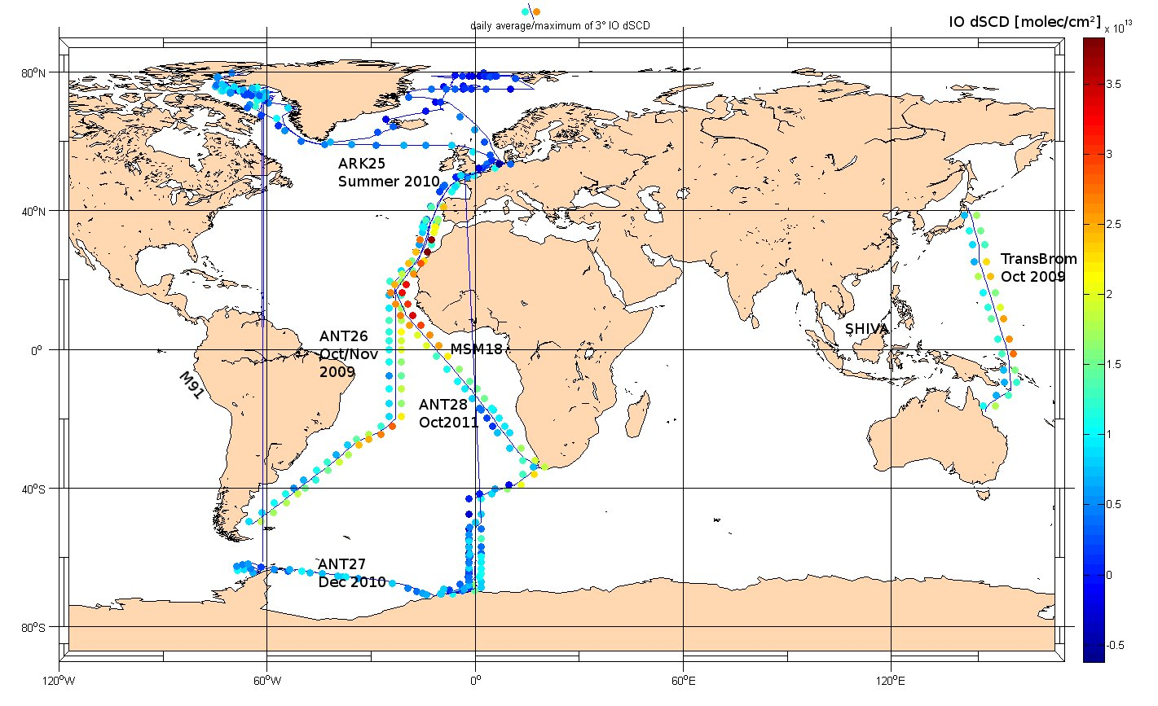
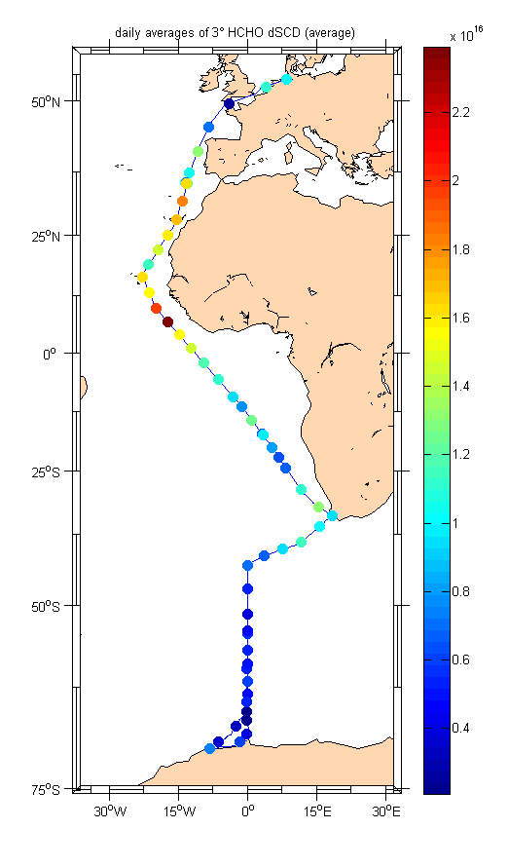
Polarstern Measurements
IO
HCHO
Average and maximum values are plotted daily left and right of the cruise track. For ANT27/ARK25 only daily averages are shown.
Johannes Lampel & Katja Großmann

